Slide 1
Systems Analysis and Design
Course Code: CSE 305
Instructor:
Dr. Shah Murtaza Rashid Al Masud
Assoc. Prof. CSE Dept., UAP

Slide 2

The Gantt Chart

Slide 3
A Gantt chart is used to graphically present the start and end dates of each software engineering task/activity
A chart in which a series of horizontal lines shows the amount of work (activity) done in certain periods of time in relation to the amount (activity) planned for that time periods.

Slide 4
The Purpose of a Gantt Chart:
To illustrate the relationship between project activities & time.
To show the multiple project activities on one chart
To provide a simple & easy to understand representation of project scheduling

Slide 5

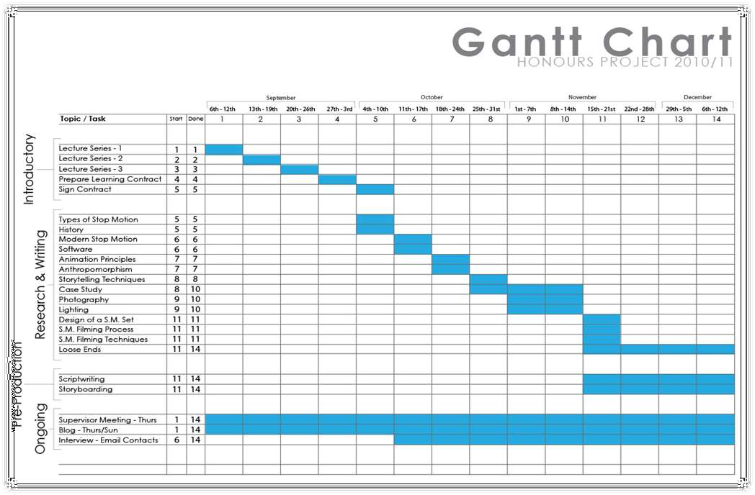
Example of a simple Gantt Chart
You will see that a Gantt Chart is basically a Bar Chart. Representin g project activities against time.

Slide 6
Creating a Gantt Chart (Process)
Identify the Purpose
Define the Project Timeline
Break the Project Down into Manageable Pieces
Create Progress Bars
Define the Critical Path
Add Milestone Markers

Slide 7
Steps to Creating a Gantt Chart:
Determine Project start date and deadline.
Gather all information surrounding the list of activities within
Breakdown Structure may be useful for this.
Determine how long each activity will take
Evaluate what activities are dependant on others
Create Graph shell including the timeline and list of activities.
a project – the Work
6. Using either Forward Scheduling or Backward Scheduling, Begin to add bars ensuring to include dependencies and the full duration for each activity.

Slide 8

Example:
Activity | Duration | Dependant On
1. Read Literature | 21 days | N/A
2. Conduct Literature Review | 14 days | 1
3. Arrange Client Visits | 7 days | N/A
4. Prepare Surveys | 5 days | 1 and 3
5. Conduct Surveys | 14 days | 4
6. Analyse Surveys | 10 days | 5
7. Write Up | 30 days | 1,2,3,4,5 and 6
Project Start Date = 1st September Deadline = 20th Decemeber

Slide 9
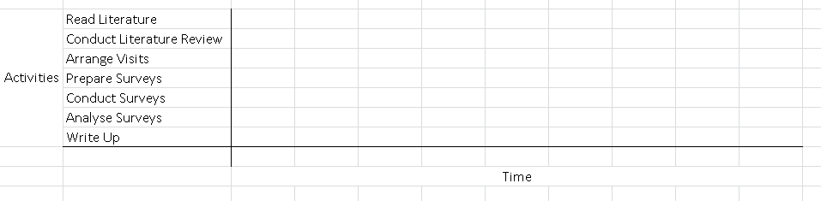
Step 5 - From the previous slide, steps 1-4 are already complete. We now need to create a ‘Graph Shell’.

Slide 10
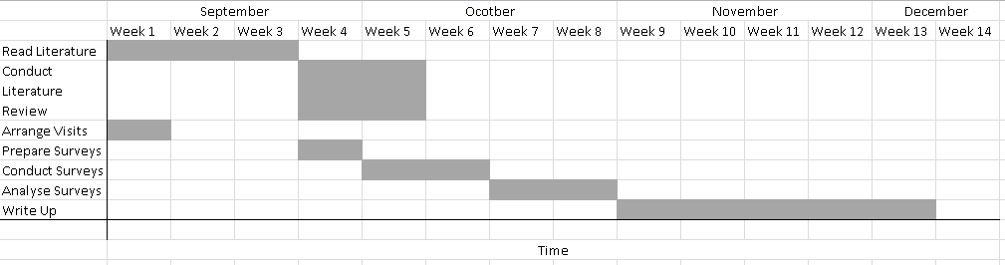
Step 6 – have a go at using either Forward Scheduling or Backward Scheduling to populate the graph.
The Finished Product

Slide 11
Gantt charts
0 A Gantt chart is used to graphically present the start and end dates of each software engineering task
0 One axis shows time.
0 The other axis shows the activities that will be performed.
0 The black bars are the top-level tasks.
0 The white bars are subtasks
0 The diamonds are milestones:
0 Important deadline dates, at which specific events may occur
11

Slide 12
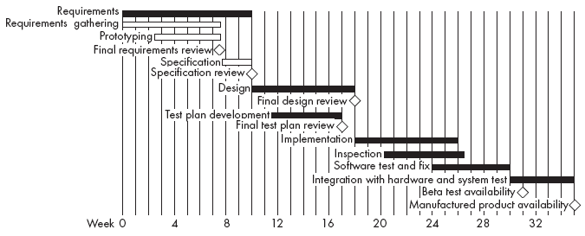
Example of a Gantt chart
12

Slide 13




Gantt Chart
Activity 1
Easy to read
Activity 2
Activity 3
Activity 4
Activity 5
0
1
2
3
4
5
6
7
Time (in weeks after start)
13

Slide 14
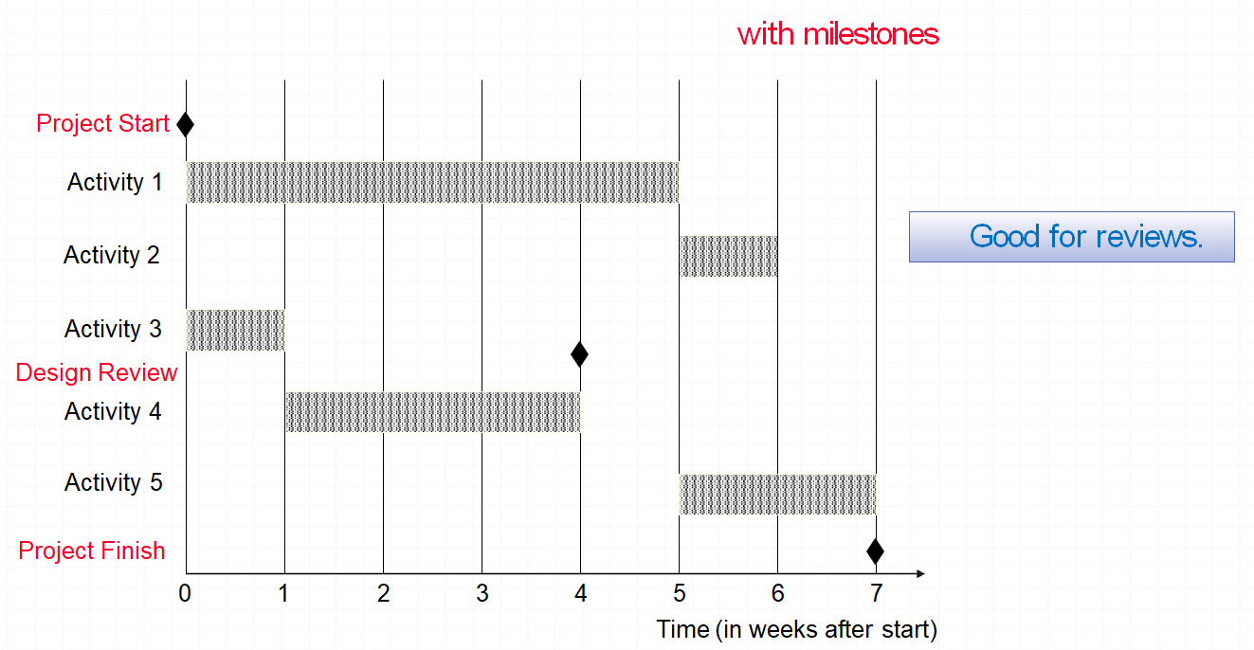
Gantt Chart

Slide 15
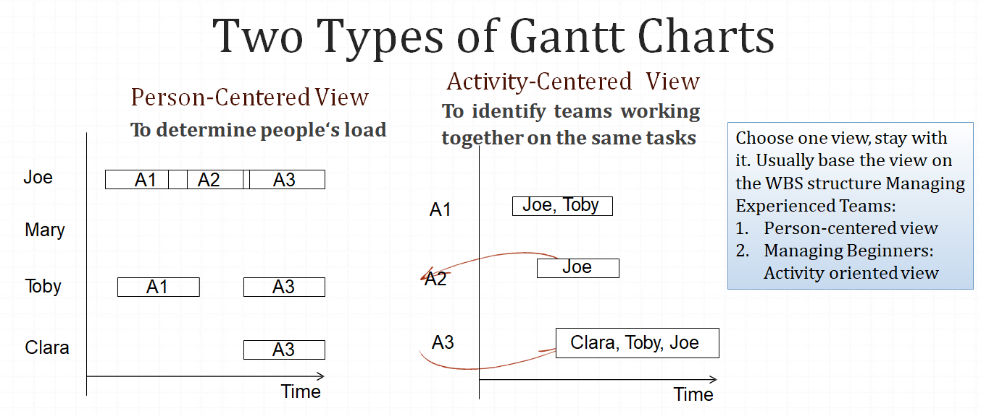
Gantt Chart

Slide 16
The Advantages:
A useful tool for displaying time-based information within a project.
Very simple to create
They provide a useful overview of project activities, a good starting point for project planning.
The charts are widely used and understood.
There exists several PC software packages that allow you to build Gantt Charts.

Slide 17
The Limitations:
The Gantt Chart does not explain the reasoning behind the chosen duration of each activity.
(Maylor, 2001)
The Gantt Chart is very difficult to update when changes to the project plan take place. This makes it time consuming and results in long-term planning being very difficult.
(Goldratt, 1997)
Gantt Charts encourage a one-step approach to planning – this prevents flexibility in project planning.
Modern day Gantt Charts, using PC software, can look very professional without actually having meaning, preventing project teams from challenging their content. This can lead to difficulties later in the project. (Maylor, 2001)
As Gantt Charts are difficult to update manually, they can often become obsolete.
The charts do not consider project costs or resources.

Slide 18
Sequence of Activities of The Project - House Building
Number | Activity | Predecessor | Duration
1 | Design house and obtain financing | -- | 3 months
2 | Lay foundation | 1 | 2 months
3 | Order and receive materials | 1 | 1 month
4 | Build house | 2,3 | 3 months
5 | Select paint | 2, 3 | 1 month
6 | Select carper | 5 | 1 month
7 | Finish work | 4, 6 M | 1 month
18

Slide 19

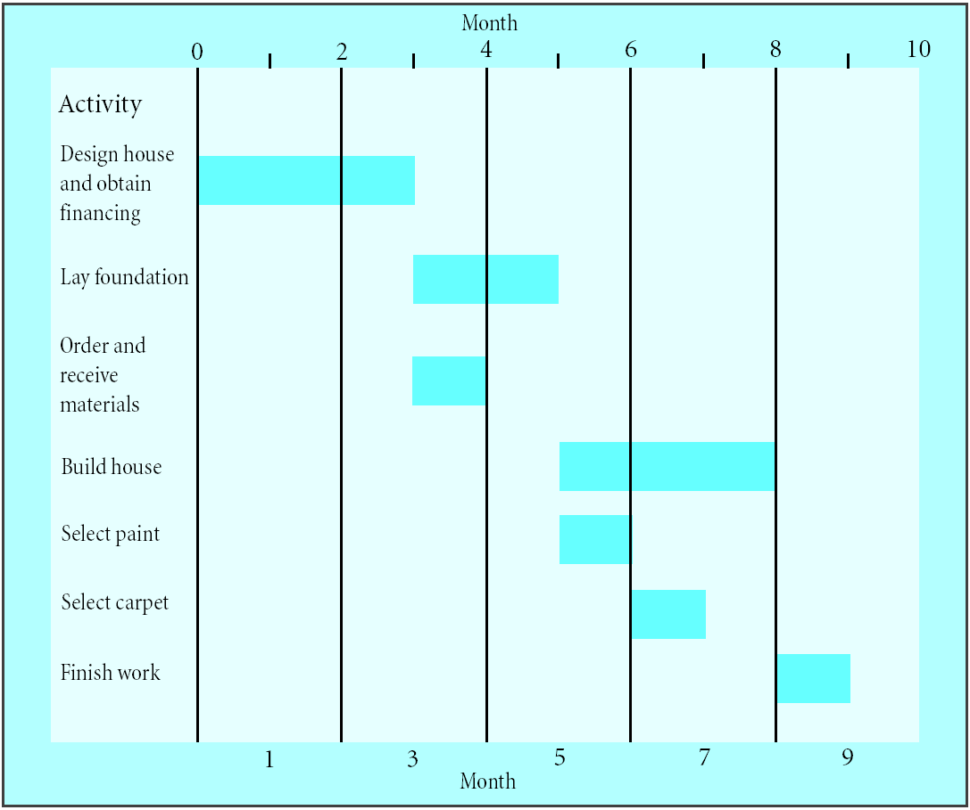
Gantt Chart for House Building Project

Slide 20
Alternatives (Recap)
PERT/GERT
Work Breakdown Structure
Critical Path Method
Resource Levelling
Many Others!

Slide 21
Program Evaluation and Review Technique (PERT):
Also a very traditional project planning technique
PERT shows the list of activities within a project, their duration and the relationship between them
PERT is a complex process however it can help to deliver a well defined project plan.

Slide 22
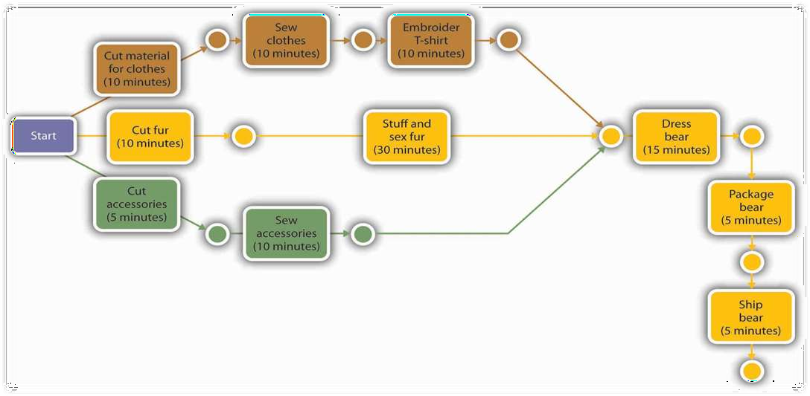
A Basic PERT Diagram:

Slide 23
Graphical | Evaluation | and | Review
Technique | (GERT):
Similar to PERT, however allows for looping, branching and the display of multiple project results.
GERT can show possibilities if a section of a project were to fail.
Further GERT reading = Meredith and Mantel

Slide 24
Sources and Further Reading:
Meredith, J. and Mantel, S. (2010) Project Management: a managerial approach, Asia: John Wiley and Sons
Maylor,H. (2003) Project Management, Essex: Pearson Education Limited,
3rd edn.
Field, M. and Keller, M. (1998), Project Management, Croatia: Thomson Learning
Goldratt, E. (1997) The Critical Chain, New York: North River Press
Kerzner, H. (2009) Project Management, New Jersey: John Wiley & Sons, 10th edn.
Maylor, H (2001) Beyond the Gantt Chart, European Management Journal,
Vol 19, No.1, pp. 92-100
Wilson, J. (2003) Gantt Charts: a Centenary Appreciation, European Journal of Operational Research, Volumne 149 pp. 430-437.

Slide 25


